Slide 1
Introduction to
Technical Writing
Good Style
Building goodwill
Half Truths About Writing
Better Style
11 Ways to Build Better Style
Draft Testing
Organizational Preferences
Recommended Resources

Slide 2
Contact Information and
Office Hours
Ms. Jessica Ponto
J.J.Ponto@Utah.edu
Office: 1706 WEB
Office Hours: T 5-6:30 p
W 11:00-12:30
and by appointment

Slide 3
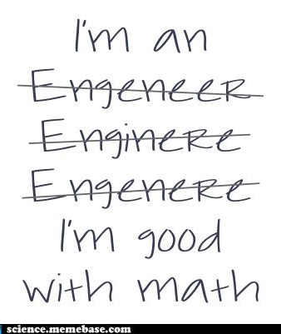
Ever feel like writing isn’t your cup of tea?

Slide 4

Good Technical Writing Style
Varies by audience; it considers the reader and builds goodwill
Maintains consistent and “good” style
  Is, above almost all, clear
Good technical writing style also
Attends to visual impact
Persuades

Slide 5
Build Goodwill: Use “You-Attitude”
“You-Attitude” is a style of writing that
  Adopts the audience’s point of view
  Emphasizes what the audience wants to know
  Protects the audience’s ego (e.g. does not use “you” to make accusations)

Slide 6
Build Goodwill: Avoid Bias
Use nonsexist language that treats both sexes neutrally.
  Job titles: Chairman vs. Chairperson
  Courtesy titles: Mrs. vs. Ms.
  Pronouns: The nurse and her patients vs. the nurse and his patients
Don’t make assumptions about your audiences’ sexual orientation, gender, marital status, etc.

Slide 7
Build Goodwill: Avoid Bias, continued…
Use nonracist and nonagist language
  Give someone’s race or age only if it is relevant to your communication.
  Refer to a group by the term it prefers.
  Avoid terms that suggest competent members of a certain group are unusual.

Slide 8
Half-Truths about Style
Write as you talk
Never use “I”
Never begin sentence with and or but
Never end sentence with preposition
Big words impress people

Slide 9
Write as You Talk: Yes . . . But
Yes
  Do it for first draft
  Read draft aloud to test
But
  Expect awkward, repetitive, badly organized prose
  Plan to revise and edit

Slide 10
Never Use I: Yes . . . But
Yes
  I can make writing seem self-centered
  I can make ideas seem tentative
  I should never appear in a resume, but it’s fine to use it in a cover letter.
But
  Use I to tell what you did, said, saw—it’s smoother

Slide 11
Never Begin Sentence with And or But
And may make idea seem like afterthought
And gives effect of natural speech
But serves as a signpost, signals a shift
But can make writing smoother

Slide 12
Never End a Sentence with a Preposition: Yes . . . But
Yes
  A preposition may not be worth emphasizing this way
  Readers expect something to follow a preposition
  Avoid in job application letters, reports, formal presentations
But
  OK now and then

Slide 13
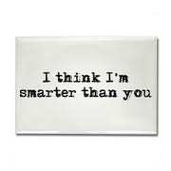
Big Words Impress People: Yes . . . But
Yes
  You may want to show formality or technical expertise
But
  Big words distance you from readers
  Big words may be
  misunderstood
  Misused words
  make you look foolish

Slide 14
Building Better Style
Write WIRMI: What I Really Mean Is
Read draft aloud to person three feet away
Ask someone to read draft aloud
No stiff words
Fix words where
reader stumbles

Slide 15

Building Better Style, continued…
Read widely; write a lot
Study revised sentences
Polish your style with the 11 techniques that follow

Slide 16
Ways to Build Better Style
Use the following tips as you:
  Draft
  Write and revise
  Draft, revise, and form paragraphs

Slide 17
1. Use Accurate, Appropriate Words
Denotation
  literal meanings; dictionary definitions
    Bypassing—two people using same word to mean different things; causes mix-ups
Connotation
  emotional association; attitude
        - / +
        nosy / curious
        fearful / cautious
        obstinate / firm

Slide 18

2. Use Familiar Words
Words most people know
Words that best convey your meaning
Shorter, more common words
Specific, concrete words

Slide 19
Use Familiar Words, continued…
Use Short, Simple, Alternatives
Stuffy Simple
reside live
commence begin
enumerate list
finalize finish, complete
utilize use

Slide 20

2. Use Familiar Words, continued…
When you use jargon, consider your audience
Jargon—special terms of technical field
  Use in job application letters
  Use when essential and known to reader

Slide 21
3. Use Active Verbs (Usually)
Active—subject of sentence does action the verb describes
Passive—subject is acted upon
  Usually includes form of “to be”
  Change to active if you can
  Direct object becomes subject

Slide 22
Passive vs. Active Verbs
P: The program will be implemented by the agencies.
A: The agencies will implement the program.
P: These benefits are received by you.
A: You receive these benefits.
P: A video was ordered.
A: The customer ordered a video.

Slide 23

Passive vs. Active Verbs, continued…
Active verbs are better because—
  Shorter
  Clearer
  More interesting
Passive verbs are better to—
  Emphasize object receiving action
  Adhere to the standards used in more conservative technical publications
  Avoid placing blame

Slide 24
4. Use Verbs to Carry Weight
Replace this phrase with a verb
make an adjustment
make a decision
perform an examination
take into consideration
= adjust
= decide
= examine
= consider

Slide 25

5. Eliminate Wordiness
Wordy—idea can be said in fewer words
Conciseness; a mark of good writing that contributes to clarity
  Omit words that say nothing
  Put the meaning in subject and verb

Slide 26
Omit Words that Say Nothing
Cut words if idea is clear without them
  . . . period of three months
  . . . at the present time
Replace wordy phrase with one word
  Ideally, it would be best to put the. . . .
  If possible, put the…
  There are three reasons for our success…
  Three reasons explain the…

Slide 27
Put Meaning of Sentence in Subject & Verb: Example
  The reason we are recommending the computerization of this process is because it will reduce the time required to obtain data and will give us more accurate data.
  Computerizing the process will give us more accurate data more quickly.
wordy
tight

Slide 28
6. Vary Sentence Length & Structure
Varying sentence length and structure helps keep audience interest
Use short sentences when subject matter is complicated
Use longer sentences to
  Show how ideas link to each other
  Avoid choppy copy
  Reduce repetition
Notes:
Multimedia Lecture Support Package to Accompany Basic Marketing
Lecture Script 6-<number>

Slide 29

Vary Sentence Length & Structure, continued…
Mix sentence structures
  Simple – 1 main clause
  Compound – 2 main clauses
  Complex – 1 main, 1 subordinate clause

Slide 30
7. Use Parallel Structure: Example
During the interview, job candidates will
  Take a skills test.
  The supervisor will interview the prospective employee.
  A meeting with recently hired workers will be held.
During the interview, job candidates will
  Take a skills test.
  Interview with the supervisor.
  Meet with recently hired workers.
faulty
parallel

Slide 31
8. Begin Most Paragraphs with Topic Sentence
Unity—paragraph discusses one idea; a mark of good writing
Topic sentence—states main idea
  Tells what paragraph is about
  Forecasts paragraph’s structure
  Helps readers remember points

Slide 32
9. Use Thesis Statements
A thesis is, essentially, a one or two-sentence version of the analysis or argument presented in a communication
Most reports should contain clear and concise thesis statements
  Readers almost instinctively look to them for guidance

Slide 33

10. Use Transitions to Link Ideas
Transition—signals the connections between ideas to the reader
  Tells if next sentence continues or starts new idea
  Tells if next sentence is more or less important than previous
  Don’t get stuck in the
  “however” rut; there are plenty
  of lists of transitions online

Slide 34
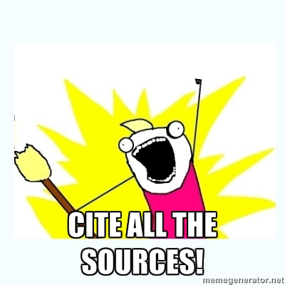
11. Cite, cite, cite
  Always cite your sources, and use the citation style your audience prefers
    Citations lend credibility and can keep you out of academic and
    legal trouble
For CH EN 4903, use a numbered list of references (option 2 in comment T34 in Example Formal Report A)

Slide 35


Test drafts on actual audiences
  How long does it take to find information they need?
  Do they make mistakes using it?
  Do they think draft is easy to use?

Slide 36
Writing Style Preferences
Good writing varies by organization, and, of course, from class to class and instructor to instructor
  Use the style your audience prefers

Slide 37

Recommended Resources
Technical Communication by Paul Anderson
Pocket Book of Technical Writing for Engineers & Scientists by Leo Finkelstein

